Slide 1

Finding the Path
Descriptions of the “Path” class of functions

Slide 2
The organization of this presentation is as follows:
Motivation and definitions
Basic “getting started” functions
Basic path operations – intersections and snapping
Functions that trim paths
Functions that project paths
Statistical analysis of paths
Path averaging methods
Working with elevated paths
Miscellaneous functions

Slide 3
A complete list of Path library functions is here:
Getting started functions: fcn_Path_checkInputsToFunctions → a powerful function that checks to see that the inputs to functions satisfy correct conditions paths = fcn_Path_fillSamplePaths → Fills test data – includes a click-to-draw diff_angles = fcn_Path_calcDiffAnglesBetweenPathSegments(Path,(fig_num))→ Calculates the change in angles between path segments yaw_angles_in_radians = fcn_Path_calcYawFromPathSegments(Path,(fig_num)) → calculates yaw angle for each path segment traversal = fcn_Path_convertPathToTraversalStructure(path,(fig_num)) → Converts paths into traversals h = fcn_Path_plotTraversalsXY(traversals,{fig_num}) → Plots the XY value of the traversals h = fcn_Path_plotTraversalsYaw(data,{fig_num}) }) → Plots the yaw values of the traversals
Basic Path Operations functions: [distance,location,path_segment] = fcn_Path_findProjectionHitOntoPath(path, sensor_vector_start, sensor_vector_end,(flag_search_type),(fig_num)) → finds intersection between a sensor and a path [intersection_points, s_coordinates_in_traversal_1, s_coordinates_in_traversal_2] = fcn_Path_findIntersectionsBetweenTraversals(traversal_1,traversal_2, (fig_num)); → finds where two traversals intersect [closest_path_point,s_coordinate,first_path_point_index,second_path_point_index,percent_along_length] = fcn_Path_snapPointOntoNearestPath(point, path,{fig_num}) → snaps a point onto the nearest path segment [closest_path_point,s_coordinate,path_point_yaw, first_path_point_index, second_path_point_index, percent_along_length] = fcn_Path_snapPointOntoNearestTraversal(point, traversal, (fig_num)) → snaps point to nearest traversal
Trimming operations: traversal_trimmed,flag_outside_start, flag_outside_end] = fcn_Path_findTraversalStationSegment( long_traversal, s_coord_start,s_coord_end, (fig_num))→ crops traversal by given station interval [traversal_no_pinch_point] = fcn_Path_removePinchPointInTraversal(traversal_with_pinch_point,(fig_num));
Projection of Paths: [unit_normal_vector_start, unit_normal_vector_end] = fcn_Path_findOrthogonalTraversalVectorsAtStations(station_queries,central_traversal, (flag_rounding_type),(fig_num)) → calculated ortho vectors at given stations [closest_path_point,s_coordinate] = fcn_Path_findOrthogonalHitFromTraversalToTraversal(query_stations,central_traversal,nearby_traversal, (flag_rounding_type),(search_radius),(fig_num)) → finds which traversals are hit at orho projections from one traversal to another [closestXs, closestYs, closestDistances] = fcn_Path_findOrthoScatterFromTraversalToTraversals(reference_station_points, reference_traversal, all_traversals,(flag_rounding_type),(search_radius),(fig_num)) → finds closest points on many traversals to a given “central” traversal. offset_traversals = fcn_Path_fillOffsetTraversalsAboutTraversal( reference_traversal, offsets, (fig_num)); → fills in an array of traversals about a reference traversal at user-defined offset distances. [closestXs, closestYs, closestDistances] = fcn_Path_convertTraversalXYtoSy(reference_station_points, reference_traversal, all_traversals,(flag_rounding_type),(search_radius),(fig_num)) → calculates the SY coordinates for a given traversal, given a reference traversal and another query traversal random_traversals = fcn_Path_fillRandomTraversalsAboutTraversal( reference_traversal, (std_deviation), (num_trajectories), (num_points), (flag_generate_random_stations), (spatial_smoothness), (fig_num)); → generates random traversals about a given traversal
Statistical Operations: fcn_Path_plotTraversalXYWithUpperLowerBands( middle_traversal, upper_traversal, lower_traversal, fig_num); → plots a central traversal with a band around it defined by an upper and lower traversal. All traversals must have same length. std_deviation = fcn_Path_calcSingleTraversalStandardDeviation( reference_traversal, (fig_num)); → estimates the standard deviation in the offsets of a single traversal using variance in path angles and average path segment length fcn_Path_plotTraversalXYWithVarianceBands( reference_traversal, (std_deviation), (fig_num)); → plots a traversal with standard deviation boundaries around it
Path Averaging Methods: [aligned_Data_ByStation,mean_Data] = fcn_Path_findAverageTraversalViaStationAlignment(data); → estimates an average traversal based on aligning traversals by station. path_average_final = fcn_Path_findAverageTraversalViaClosestPoint( data, reference_traversal, (flag_calculate_reference_traversal),(num_iterations)) → estimates an average traversal based on closest point [new_traversal] = fcn_Path_newTraversalByStationResampling(input_traversal, new_stations, (fig_num)) → redecimates a traversal at given station points [traversal_average, closestXs, closestYs, closestDistances] = fcn_Path_findAverageTraversalViaOrthoProjection( data, (reference_traversal), (num_iterations), (weight_for_averaging), (fig_num));→ estimates average traversal using orthogonal projection index_of_longest = fcn_Path_findTraversalWithMostData(data) → finds the traversal in a traversals array with the most data (most elements in X array) clean_path = fcn_Path_cleanPathFromForwardBackwardJogs(path_with_jogs, (fig_num)) → removes back/forth jogs from data [closestXs,closestYs,closestZs,closestYaws] = fcn_Path_findClosestPointsToTraversal(path,data,(flag_yaw), (flag_3D),(fig_num)) → finds closest points on a set of traversals to reference traversal
Elevated Paths: elevated_path = fcn_Path_addElevationToPath(path, reference_elevated_path, (fig_num))

Slide 4
Motivation and Definitions for the Path library of functions
Updated 2021-12-10 by S. Brennan

Slide 5

Many applications require a reference path, but particularly driving.a
For example, roads are a form of path. The task of driving is to stay on the road, which means that a vehicle’s position relative to the path – the offset to the path, travel along the path, angle relative to path, etc. - are all basically path calculations.

Slide 6
Definitions of terms are important so that we don’t get confused later
Station
Stations
Path
Paths
Traversal
Traversals

Slide 7
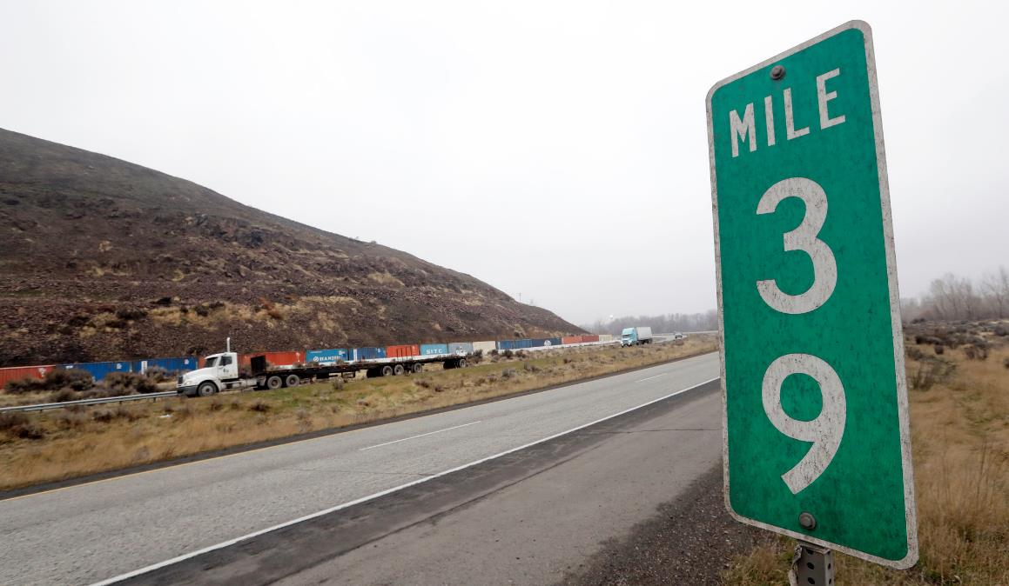
The station of a path is the location in terms of the s-coordinate along a path
For example, mile markers on a road are a station type of measurement; they do not represent distance to a specific point, but rather represent how far along a road someone has traveled relative to some start location and independent of the curvature of the road. In this case, the station is “39 miles”.
For our work, we nearly always measure station in meters.

Slide 8
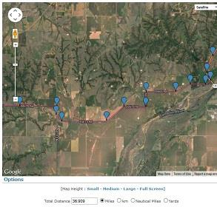
The important aspect of the station is that it does NOT depend on Euclidian distance from a location.
The station distance is distance ALONG a path, so if a path is curvy, then the station distance from a point can be very large even if the point is relatively close in straight-line distance. In fact, for curvy paths, the Euclidean distance may be rise, fall, and then rise again as vehicles drive “away” from a point!

Slide 9
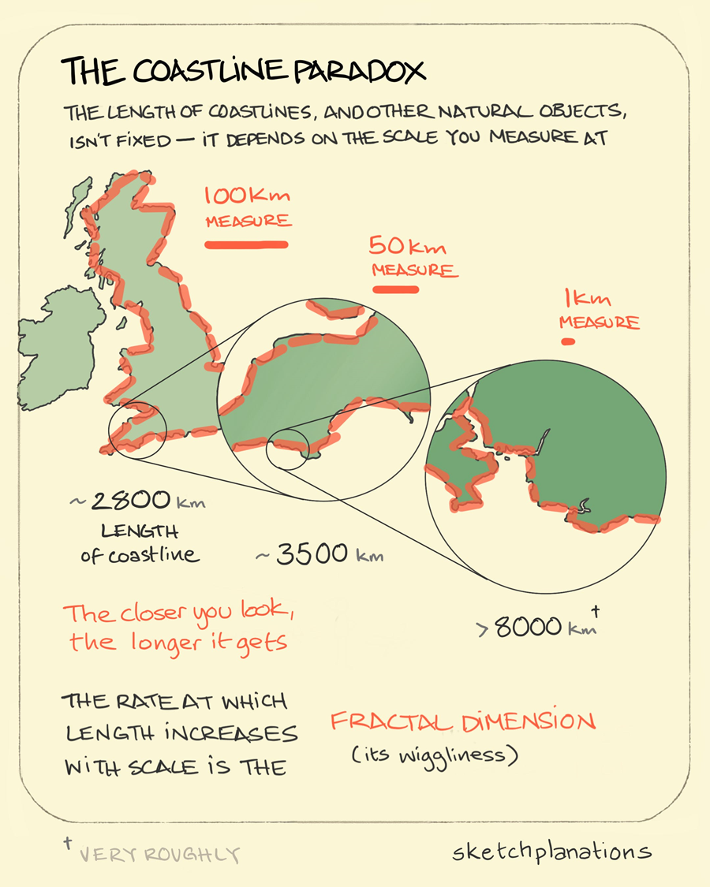
An issue with station coordinates is that, without smoothing of edges, they suffer from the fractal problem.
The fractal problem arises in measuring the length of a shoreline (see here for example), which tends to infinity as resolution increases (for a snapshot in time), or tends to Allan Variance minima if time-changing distances are included. This falls into the class of problems called “intermediate asymptotics”, “self similarity”, and “fractal dimension. And this particular problem is called the “Coastline paradox.”
https://sketchplanations.com/the-coastline-paradox

Slide 10
1
B
2
A
C

Slide 11
The length of a path depends very strongly on how much “weaving” is occurring. In comparing “similar” paths plotted at same station points – in this case every 40 meters – each path’s station may be very distant from its neighbors.
%% Example 2: Show station discrepancies
% Plot station markers
fig_num = 2;
figure(fig_num);
clf;
hold on;
grid on;
grid minor;
Station_step = 40;
fcn_Path_plotTraversalsXY(data,fig_num);
xlabel('X [m]');
ylabel('Y [m]');
for i_traveral = 1:length(paths)
traversal_stations = data.traversal{i_traveral}.Station;
for i_station = Station_step:Station_step:traversal_stations(end)
index = find(traversal_stations >= i_station,1);
plot(data.traversal{i_traveral}.X(index),...
data.traversal{i_traveral}.Y(index),...
'k.','Markersize',15);
text(data.traversal{i_traveral}.X(index),...
data.traversal{i_traveral}.Y(index),...
sprintf('Station: %.2f',...
data.traversal{i_traveral}.Station(index)));
end
end

Slide 12
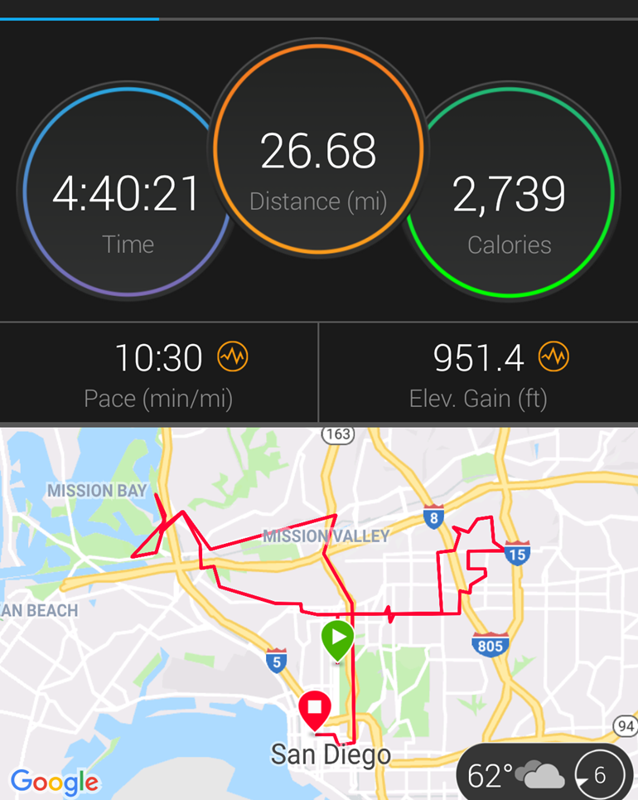
This side-side swerving is why marathon runners ALWAYS end up running more than 26.2 miles (which often surprises and annoys first-time runners)

Slide 13

Most of our challenges with vehicle guidance have to do with the fact that the station distance on one side of the road is different than on the other. We need a COMMON station for the road or lane.

Slide 14
When we operate in code, we treat station as a 1 x 1 scalar, and stations (plural) as a N x 1 vector
This way, if a function needs multiple stations, it can query the arguments for a vector ‘stations’ rather than a scalar ‘station’. So a stations type variable consists of N “station” variables stacked together.

Slide 15
What is a path?
A path is a set of [X Y] points as a N x 2 vector or array. These X Y rows denote the locations we are trying to follow which defines the path. For example:
A path type must have at least 2 rows so that a single “path segment” can be defined.
paths{1} = [
8.1797 8.6006
8.4101 15.8892
10.0230 25.5102
10.4839 39.7959];

Slide 16
What is a path segment?
One connection between vertices is called a “path segment”, and a path must have at least ONE segment

Slide 17
Some operations require at least 2 segments, and we refer to these variable types as “paths”
The use of plural is to denote a type of variable that has multiple segments. An example operation that requires multiple segments is when we need to calculate the angles between segments.
We rarely use multiple paths as we have another variable type, traversals, discussed next. So hopefully this is not confusing!
This is a path type
This is a “paths” type OR a “path” type

Slide 18
Sometimes we want more information about a path than just XY, so we define something called a “traversal”
function traversal = fcn_Path_convertPathToTraversalStructure(path,varargin)
% fcn_Path_convertPathToTraversalStructure
% Takes a Path type and creates it to a traversal structure
%
% FORMAT:
%
% traversal = fcn_Path_convertPathToTraversalStructure(path,(fig_num))
%
% INPUTS:
%
% path: an N x 2 vector of [X Y] positions, with N>=2
%
% OUTPUTS:
%
% traversal: a sttructure containing the following fields
% - X: an N x 1 vector that is a duplicate of the input X
% - Y: an N x 1 vector that is a duplicate of the input Y
% - Z: an N x 1 vector that is a zero array the same length as
% the input X
% - Diff: a [N x 2] array that is the change in X and Y
% (front-padded with [0 0])
% - Station: the XY distance as an N x 1 vector, representing
% the distance traveled up to the current point (starting with 0
% at the first point)
% - Yaw: the calculated yaw angle (radians) of each path segment
% (note: there are N-1 segments if there are N points, thus
% there are N-1 Yaw points)
% (thus - it is front-padded with NaN)
%
% (OPTIONAL INPUTS)
%
% fig_num: a figure number to plot results.
It includes subfields that are routinely used, particularly the Station and Yaw. We convert from Path to Traversals often, so a function exists that will fill in a Traversal given a Path.

Slide 19
The last major type commonly used is “traversals” which are collections of traversal variables within an array, e.g. many “paths” that are together
An example would be:
Many_traversals.traversal{1} = some_traversal;
Many_ traversals.traversal{2} = some_other_traversal;
Etc. So, the variable ‘Many_ traversals’ is a “traversals” type and contains an array of different traversals together. This variable allows us to create functions that operate on many traversals at the same time (such as plotting, averaging, variance calculations, etc.)

Slide 21
Basic “getting started” functions in the library
Updated 2022-01-07 by S. Brennan

Slide 22
Basic getting started operations include
Checking the inputs to functions Defining starter paths Letting users draw their own paths Examining path angles Converting paths into traversals and plotting
These basic functions are described below.

Slide 23
Checking the inputs to functions

Slide 24
The function fcn_Path_checkInputsToFunctions is a general-use function whose only purpose is to confirm that variables that are passed to it meet the requirements of each type.
This is called “fcn_Path_checkInputsToFunctions”
It is often called repeatedly at the top of other codes to check that the inputs are the correct type.
function fcn_Path_checkInputsToFunctions(...
variable,variable_type_string)
% fcn_Path_checkInputsToFunctions
% Checks the variable types commonly used in the Path class to ensure that
% they are correctly formed. This function is typically called at the top
% of most Path class functions. The input is a variable and a string
% defining the "type" of the variable. This function checks to see that
% they are compatible. For example, the 'path' type variables in the class
% function are N x 2 arrays of [x y] pairs; if someone had a path variable
% called "path_example", they could check that this fit the path type by
% calling fcn_Path_checkInputsToFunctions(path_example,'path'). This
% function would then check that the array was N x 2, and if it was not, it
% would send out an error warning.
%
% FORMAT:
%
% fcn_Path_checkInputsToFunctions(...
% variable,variable_type_string)
%
% INPUTS:
%
% variable: the variable to check
%
% variable_type_string: a string representing the variable type to
% check. The current strings include:
%
% 'station' - checks that the station type is N x 1 and is a
% number.
%
% 'stations' - checks that the station type is N x 1 and is a
% number, with N >= 2
%
% 'path' - checks that the path type is N x 2 with N>=2
%
% 'paths' - checks that the path type is N x 2 with N>=3
%
% 'traversal' - checks if a structure with X, Y, and Station,
% and that each has an N x 1 vector within all of same length.
% Further, the Station field must be strictly increasing.
%
% 'traversals' - checks if a structure containing a subfield
% that is a cell array of traveral{i}, e.g. "data.traversal{3}",
% with each traversal also meeting traversal requirements.
%
% Note that the variable_type_string is not case sensitive: for
% example, 'station' and 'Station' or 'STAtion' all give the same
% result.
%
% OUTPUTS:
%
% No explicit outputs, but produces MATLAB error outputs if conditions
% not met, with explanation within the error outputs of the problem.

Slide 25
Nearly all the functions use an input checking system,
As of Dec. 2021, we are working to create a utility that will replace this (a better version exists in the Debug repo)
%% Show how input arguments are checked, fcn_Path_checkInputsToFunctions
% TO-DO - move debug tools into utilities and remove the checkinputs capability out of Path class
path_test = [4 1; 2 1];
fcn_Path_checkInputsToFunctions(path_test, 'path');

Slide 26
Defining starter paths

Slide 27
We’re often creating paths, but for dummy “starter” paths we have a function to create samples
END
It fills in (currently) three different paths in an array, which is easily converted into a “traversals” type.
Note: a click-to-draw functionality also exists by setting a flag within the function itself. This allows interactive creation of paths in this function!
START
% Fill in some dummy data
paths = fcn_Path_fillSamplePaths;

Slide 28
Why do we use this example? It has some challenging features that often “break” code
Each traversal has a VERY different number of points and station distances
The traversals cross each other repeatedly
They have different start/stop XY locations
Each traversal loops back on itself, which breaks Euclidean distance-based queries

Slide 29
Letting users draw their own paths

Slide 30
The function, fcn_Path_fillPathViaUserInputs allows the user to click in a figure to define test paths.
This is a function for the user to click on the figure to generate XY path. Points are collected and plotted until the user double clicks.

Slide 31
Examining path angles

Slide 32
To convert paths to traversals, we use two functions to deal with yaw angles:
One uses dot products and cross products to find the relative change in a path’s angle. This avoids the use of arctan which does not work when segments are pointing toward -180 degrees
The other accumulates these changes to find the yaw angle along a path.
% Pick first path as reference_traversal structure
paths_array = fcn_Path_fillSamplePaths;
paths_to_check = paths_array{1};
fig_num = 11111;
diff_angles = fcn_Path_calcDiffAnglesBetweenPathSegments(paths_to_check,fig_num);
%% Show how to calculate the yaw angles along a path, fcn_Path_calcYawFromPathSegments
% Basic call with one path
fig_num = 22222;
yaw_angles = fcn_Path_calcYawFromPathSegments(path_to_check,fig_num); %#ok<*NASGU>

Slide 33
Converting paths into traversals and plotting

Slide 34
Because the row length of each traversal is different, we cannot save these as arrays (not easily, at least). So, we use structure types to save traversals to allow different lengths (see next slide for code).

Slide 35
We often collect traversal data into cell arrays called traversals. And we often need to plot them. A function exists for this too.
% script_test_fcn_Path_plotTraversalsXY.m
% Tests fcn_Path_plotTraversalsXY
close all
clc
% Fill in some dummy data
paths = fcn_Path_fillSamplePaths;
% Convert paths into traversals
for i_traveral = 1:length(paths)
traversal = fcn_Path_convertPathToTraversalStructure(paths{i_traveral});
data.traversal{i_traveral} = traversal;
end
%% Call the plot command to show how it works. figure(11);
fcn_Path_plotTraversalsXY(data);

Slide 36
Similarly, we often want to plot the yaw within traversal arrays and a function exists for this too
% script_test_fcn_Path_plotTraversalsYaw.m
% tests fcn_Path_plotTraversalsYaw
clc
close all
% Fill in some dummy data
paths = fcn_Path_fillSamplePaths;
% Convert paths into traversals
for i_traveral = 1:length(paths)
traversal = fcn_Path_convertPathToTraversalStructure(paths{i_traveral});
data.traversal{i_traveral} = traversal;
end
%% Call the plot command to show how it works. First, put it into our figure
% to show that it will auto-label the axes and create a new figure (NOT
% figure 11 here) to plot the data.
figure(11);
fcn_Path_plotTraversalsYaw(data);
%% Next, specify the figure number to show that it will NOT auto-label the
% axes if figure is already given and it puts the plots into this figure.
fig_num = 12;
fcn_Path_plotTraversalsYaw(data,fig_num);

Slide 37
Basic path operations
Updated 2022-01-10 by S. Brennan

Slide 38
Basic Path Operations Include
Finding the intersection of segments: Finding the intersection of traversals Snapping a point onto a path Snapping a point onto a traversal
These basic functions are described below.

Slide 39
Finding percentage length of a vector given percentage length along another vector

Slide 40
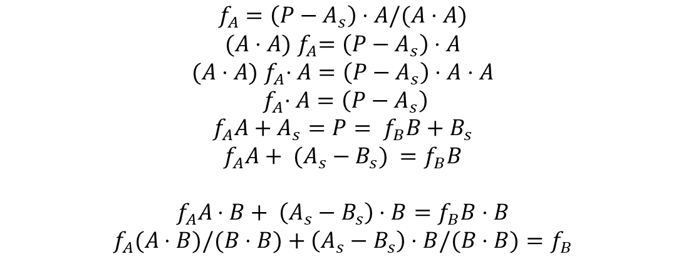
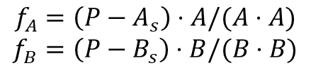
Given two vectors, A, B, we often need to find the percentage length of B given percentage length of A
Define the fractions in directions A and B as:
If A and B are colinear, then the test point is on A and B:
$$f_{A}=\left(P−A_{s}\right)⋅A/(A⋅A)$$
$$f_{B}=\left(P−B_{s}\right)⋅B/(B⋅B)$$
A vector
Astart
Test point
$$f_{A}=\left(P−A_{s}\right)⋅A/(A⋅A)$$
$${(A⋅A) f}_{A}=\left(P−A_{s}\right)⋅A$$
$${(A⋅A) f}_{A}⋅A=\left(P−A_{s}\right)⋅A⋅A$$
$${ f}_{A}⋅A=\left(P−A_{s}\right)$$
$f_{A}A+A_{s}=P= f_{B}B+B_{s}$
$$f_{A}A+ (A_{s}−B_{s}) =f_{B}B$$
$$f_{A}A⋅B+ \left(A_{s}−B_{s}\right)⋅B=f_{B}B⋅B$$
$$f_{A}(A⋅B)/(B⋅B)+\left(A_{s}−B_{s}\right)⋅B/(B⋅B)=f_{B}$$
B vector
Bstart

Slide 41
This operation is done in:
Note: this function is used for intersection testing in collinear cases.

Slide 42
Finding the intersection of segments

Slide 43
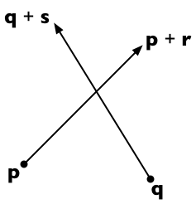
The most basic path operation is finding the intersection of a path segment rooted at p and extending to p+r, with a sensor rooted at q and extending to p+s.
Details can be found at: https://stackoverflow.com/questions/563198/how-do-you-detect-where-two-line-segments-intersect

Slide 44
This capability is implemented in fcn_Path_findProjectionHitOntoPath.m
% fcn_Path_findProjectionHitOntoPath calculates hits between a sensor
% projection and a path, returning the distance and location of the hit.
%
% FORMAT:
%
% [distance,location] = ...
% fcn_Path_findProjectionHitOntoPath(path,...
% sensor_vector_start,sensor_vector_end,...
% (flag_search_type),(fig_num))
%
% INPUTS:
%
% path: an N x 2 vector containing the X,Y points of the path to be
% checked for intersections
%
% sensor_vector_start: a 1 x 2 vector containing the X,Y points of the
% sensor's start location
%
% sensor_vector_end: a 1 x 2 vector containing the X,Y points of the
% sensor's end location
%
% (OPTIONAL INPUTS)
% flag_search_type: an integer specifying the type of search.
%
% 0: return distance and location only if the given
% sensor_vector overlaps the path (this is the default)
%
% 1: return distane and location if any projection of the sensor
% vector, in any direction, hits the path (in other words, if
% there is any intersection). Note that distance returned will
% be negative if the nearest intersection is in the opposite
% direction of the given sensor vector.
%
% fig_num: a figure number to plot results. Turns debugging on.
%
% OUTPUTS:
%
% distance: a 1 x 1 scalar representing the distance to the closest
% intersection of the sensor with the path
%
% location: a 1 x 2 vector of the X,Y location of intersection point

Slide 45
This method requires the definition of the cross product
Define the 2-dimensional vector cross product v × w to be v_{x} w_{y} − v_{y} w_{x}.
%% Calculate cross products
function result = crossProduct(v,w)
result = v(:,1).*w(:,2)-v(:,2).*w(:,1);
end

Slide 46
The method used is to consider fractions of the path and of the sensor vectors
Suppose the path segment runs from p to p + r and sensor starts from q and extends to q + s. Then any point on the first line is representable as p + t r (for a scalar parameter t) and any point on the second line as q + u s (for a scalar parameter u).
“wall”
“sensor”

Slide 47
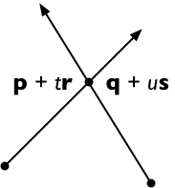
The two lines intersect if we can find t and u such that:
p + t r = q + u s
To solve, cross both sides with s, getting
(p + t r) × s = (q + u s) × s
And since s × s = 0, this means
t (r × s) = (q − p) × s
And therefore, solving for t:
t = (q − p) × s / (r × s)
“wall”
“sensor”
p
q

Slide 48
We can solve for u similarly:
(p + t r) × r = (q + u s) × r
u (s × r) = (p − q) × r
u = (p − q) × r / (s × r)
To reduce the number of computation steps, it's convenient to rewrite this to reuse the as follows (remembering that s × r = − r × s):
u = (q − p) × r / (r × s)

Slide 49
If the lines are parallel then r × s = 0
Of note, if also the “sideways” distance, e.g. (q − p) × r = 0, then the lines are co-linear as well.
In the collinear case, we express the endpoints of the second segment (q and q + s) in terms of the equation of the first line segment (p + t r):
t₀ = (q − p) · r / (r · r)
t₁ = (q + s − p) · r / (r · r) = t₀ + s · r / (r · r)
If the interval between t₀ and t₁ intersects the interval [0, 1] then the line segments are collinear and overlapping (Case 1 on the Stackoverflow discussion); otherwise, they are collinear and disjoint (Case 2 on the Stackoverflow).
Note, as mentioned in that article, that if s and r point in opposite directions, then s · r < 0 and so the interval to be checked is [t₁, t₀] rather than [t₀, t₁].

Slide 50
What are the “u” values for overlap?
These u-values represent where the “wall” is, relative to the sensor:
u₀ = (p − q) · s / (s · s)
u₁ = (p + r − q) · s / (s · s) = u₀ + s · r / (s · s)
How can we find u from t?

Slide 51
If parallel and non-intersecting?
If r × s = 0 and (q − p) × r ≠ 0, then the two lines are parallel and non-intersecting

Slide 52
What if they intersect?
If r × s ≠ 0 and 0 ≤ t ≤ 1 and 0 ≤ u ≤ 1, the two line segments meet at the point p + t r = q + u s. Otherwise, the two line segments are not parallel but do not intersect.
Credit: this method is the 2-dimensional specialization of the 3D line intersection algorithm from the article "Intersection of two lines in three-space" by Ronald Goldman, published in Graphics Gems, page 304. In three dimensions, the usual case is that the lines are skew (neither parallel nor intersecting) in which case the method gives the points of closest approach of the two lines.

Slide 53
Intersections at the end-points of the path
If intersections occur at the end-points of a path segment, then results can be ambiguous because t = 0 or t=1. In these cases, can have weird situations if we omit this, e.g. the following:
((0<t).*(1>t).*(0<u).*(1>u));
The result of this condition is that NO intersection would be detected

Slide 54
If we correct the t-range, then the intersection is found
good_vector = ((0<=t).*(1>=t).*(0<u).*(1>u));

Slide 55
Similarly, this form with the u range not including 0 or 1 can miss paths that barely hit the sensor at start or end
Missing the origin is a particularly bad error as it would cause one to miss overlapping paths

Slide 56
Here’s the correct result
good_vector = ((0<=t).*(1>=t).*(0<=u).*(1>=u));

Slide 57
Example 1: A simple intersection
See: script_test_fcn_Path_findProjectionHitOntoPath.m
%% Simple test 1 - a simple intersection
fprintf(1,'Simple intersection result: \n');
path = [0 10; 10 10];
sensor_vector = [2 1; 5 15];
fig_debugging = 2343;
[distance,location] = ...
fcn_Path_findProjectionHitOntoPath(path,sensor_vector,fig_debugging);
print_results(distance,location);

Slide 58
Example 2: Not intersecting
See: script_test_fcn_Path_findProjectionHitOntoPath.m
%% Simple test 2 - no intersections
fprintf(1,'No intersection result: \n');
path = [-4 10; 2 10];
sensor_vector = [0 0; 5 12];
fig_debugging = 2343;
[distance,location] = ...
fcn_Path_findProjectionHitOntoPath(path,sensor_vector,fig_debugging);
print_results(distance,location);

Slide 59
Example 3: Multiple line segments
See: script_test_fcn_Path_findProjectionHitOntoPath.m
%% Simple test 3 - multiple intersections
fprintf(1,'Multiple intersections result: \n');
path = [0 10; 10 10; 0 6; 10 6; 0 2];
sensor_vector = [0 0; 5 12];
fig_debugging = 2343;
[distance,location] = fcn_Path_findProjectionHitOntoPath(...
path,sensor_vector,fig_debugging);
print_results(distance,location);

Slide 60
In some applications, the “length” of the sensor vector is irrelevant. One simply wants to know any location, in any direction, where an intersection could occur.
The flag_search_type variable can be set to 1 (instead of 0, default) to specify that any intersection will work. Here’s an example with a sensor vector of length 2. If an “unlimited” search is used, a hit is detected with either positive or negative distance.
flag_search_type = 0
flag_search_type = 1

Slide 61
In some applications, we want to know all the intersection points
The flag_search_type variable can be set to 2, and all the intersections are given.
flag_search_type = 0
flag_search_type = 2

Slide 62
Here is the code and screen output for the previous slide:
%% Advanced test 2 - multiple intersections
fprintf(1,'Single intersections reporting only first result: \n');
path = [0 10; 10 10; 0 6; 10 6; 0 2];
sensor_vector_start = [0 0];
sensor_vector_end = [5 12];
fig_debugging = 23487;
flag_search_type = 0;
[distance,location] = ...
fcn_Path_findProjectionHitOntoPath(...
path,sensor_vector_start,sensor_vector_end,...
flag_search_type,fig_debugging);
print_results(distance,location);
fprintf(1,'Multiple intersections reporting all results: \n');
path = [0 10; 10 10; 0 6; 10 6; 0 2];
sensor_vector_start = [0 0];
sensor_vector_end = [5 12];
fig_debugging = 23488;
flag_search_type = 2;
[distance,location] = ...
fcn_Path_findProjectionHitOntoPath(...
path,sensor_vector_start,sensor_vector_end,...
flag_search_type,fig_debugging);
print_results(distance,location);
Single intersections reporting only first result:
Distance Location X Location Y
2.600 1.000 2.400
Multiple intersections reporting all results:
Distance Location X Location Y
10.833 4.167 10.000
7.800 3.000 7.200
6.500 2.500 6.000
2.600 1.000 2.400

Slide 63
The algorithm is quite robust even to complex overlapping conditions
GIVES:
Super overlapping colinear BACKWARDS result:
Distance Location X Location Y PathSegment
5.000 10.000 10.000 1
5.000 10.000 10.000 2
1.000 14.000 10.000 3
0.000 15.000 10.000 4
15.000 0.000 10.000 1
1.000 14.000 10.000 4
%% Advanced Multihit Overlapping test 32 - super overlapping colinear 1 BACKWARDS
fprintf(1,'Super overlapping colinear BACKWARDS result: \n');
path = [0 10; 10 10; 12 8; 14 10; 15 10];
sensor_vector_end = [-3 10];
sensor_vector_start = [15 10];
fig_debugging = 2343;
flag_search_type = 2;
[distance,location,path_segments] = ...
fcn_Path_findProjectionHitOntoPath(...
path,sensor_vector_start,sensor_vector_end,...
flag_search_type,fig_debugging);
print_more_results(distance,location,path_segments);

Slide 64
Finding the intersection of traversals

Slide 65
To find the intersection of a traversal with another, we use: fcn_Path_findIntersectionsBetweenTraversals
See script_test_fcn_Path_findIntersectionsBetweenTraversals for this demo

Slide 66
Snapping a point onto a path

Slide 67
One of the basic path operations is snapping from a query point onto a path
The goal is to find the point ON A PATH that is “closest” to the query point. One way to do this is to find the closest vertex on a path to a query point. That closest vertex is connected to 1 or 2 other points. If 1 point, it is a start or end, so we use the projection to that start/end segment. If 2 points, we snap the query to both to see which of these 2 points is closest to the query point. However, the behavior depends on regions.

Slide 68
After back
Before front
In back
Before front
B
After back
In front
Back Segment
In back
In front
A
Front Segment
C

Slide 69
This functionality is implemented in the MATLAB function: fcn_Path_snapPointOntoNearestPath
%% BASIC example 1.2 - works
point = [1.4 1.3]; % Define the query point
pathXY = [0 0; 0.5 0.2; 0.9 0.9; 1.5 0.6; 3 0]; % Define an XY path
fignum = 112; % Define the figure number
% Snap the point onto the path
[closest_path_point,s_coordinate,...
first_path_point_index,second_path_point_index,...
percent_along_length] = ...
fcn_Path_snapPointOntoNearestPath(point, pathXY,fignum);
% Print results to the workspace
fprintf(1,'Figure: %d\n',fignum);
fprintf(1,'\t\t Closest point is: %.2f %.2f \n',...
closest_path_point(1,1),closest_path_point(1,2));
fprintf(1,'\t\t Matched to the path segment given by indices %d and %d, \n',...
first_path_point_index,second_path_point_index);
fprintf(1,'\t\t S-coordinate is: %.2f, \n',...
s_coordinate);
fprintf(1,'\t\t percent_along_length is: %.2f\n',percent_along_length);
(Worspace shows)
Figure: 112
Closest point is: 1.14 0.78
Matched to the path segment given by indices 3 and 4,
S-coordinate is: 1.61,
percent_along_length is: 0.40

Slide 70
This breaks if the nearest segment is not the one with two closest endpoints
%% BASIC example 1.3 - breaks
point = [1.5 1];
pathXY = [0 0; 0.5 0.2; 0.9 0.9; 3 0];
pathSXY = fcn_Path_convertXYtoSXY(pathXY(:,1),pathXY(:,2));
fignum = 113;
% Snap the point onto the path
[closest_path_point,s_coordinate,...
first_path_point_index,second_path_point_index,...
percent_along_length] = ...
fcn_Path_snapPointOntoPath(point, pathSXY,fignum);
% Print results to the workspace
fprintf(1,'Figure: %d\n',fignum);
fprintf(1,'\t\t Closest point is: %.2f %.2f \n',...
closest_path_point(1,1),closest_path_point(1,2));
fprintf(1,'\t\t Matched to the path segment given by indices %d and %d, \n',...
first_path_point_index,second_path_point_index);
fprintf(1,'\t\t S-coordinate is: %.2f, \n',...
s_coordinate);
fprintf(1,'\t\t percent_along_length is: %.2f\n',percent_along_length);
Figure: 113
Closest point is: 1.09 1.23
Matched to the path segment given by indices 2 and 3,
S-coordinate is: 1.73,
percent_along_length is: 1.48

Slide 71
One idea to fix these errors might be to check whether the “snap” point is on a segment, but there are queries that occur where the result would be on neither segment. For example:

Slide 72
In vehicle preview-based control, the ambiguity of the snap point can cause unexpected behavior depending on whether the projection is from the path to vehicle, or vehicle to path
Vehicle
Look ahead
Vehicle
Vehicle
Vehicle
Snap is orthogonal to segment associated with look-ahead point, e.g. projection is from look-ahead path to vehicle
Snap point
Snap is orthogonal to segment associated with vehicle’s position, e.g. projection is from current path to vehicle
Snap is orthogonal to look-ahead vector, e.g. projection is from vehicle to path
Snap is orthogonal to current path segment, e.g. projection is from path to vehicle

Slide 73
Snapping a point onto a traversal

Slide 74
This has the same functionality as snap-to-path, but takes in a traversal type
Figure: 111,
Closest point is: 0.50 0.00
Matched to the path segment given by indices 1 and 2,
S-coordinate is: 0.50,
percent_along_length is: 0.50
point = [0.5 0.2];
pathXY = [0 0; 1 0; 2 0; 2 1];
traversal = fcn_Path_convertPathToTraversalStructure(pathXY);
fignum = 111;
[closest_path_point,s_coordinate,path_point_yaw,first_path_point_index,...
second_path_point_index,percent_along_length] = ...
fcn_Path_snapPoinxtOntoNearestTraversal(point, traversal,fignum);
fprintf(1,'Figure: %d,\n\t\t Closest point is: %.2f %.2f \n\t\t Matched to the path segment given by indices %d and %d, \n\t\t S-coordinate is: %.2f, \n\t\t percent_along_length is: %.2f\n',...
fignum, closest_path_point(1,1),closest_path_point(1,2),...
first_path_point_index,second_path_point_index, ...
s_coordinate, percent_along_length);

Slide 75
Trimming a path

Slide 76
Basic trimming operations include
Trimming out sections of traversals given certain station points Removing pinch points within a traversal
These basic functions are described below.

Slide 77
Trimming out sections of traversals given certain station points

Slide 78
When snapping points onto paths or traversals, if we include too much of a path, particularly one turned back toward itself, we can get incorrect snap points.

Slide 79
A fix to this problem is to trim down the traversal to include only the region we are interested in.

Slide 80
To force a query to include only a short part of a traversal, we use: fcn_Path_findTraversalStationSegment
See script_test_fcn_Path_findTraversalStationSegment.m for this demo

Slide 81
Here’s the setup and an example call
% script_test_fcn_Path_findTraversalStationSegment.m
% This is a script to exercise the function:
% fcn_Path_findTraversalStationSegment.m
% This function was written on 2020_11_16 by S. Brennan
% Questions or comments? sbrennan@psu.edu
% [traversal_trimmed,flag_outside_start, flag_outside_end] = ...
% fcn_Path_findTraversalStationSegment(...
% long_traversal, s_coord_start,s_coord_end,
% (fig_num))
% Revision history:
% 2021_01_09
% -- updated name and types to take traversal inputs
% -- added input checking
% -- added flag_do_plots
close all;
clear data;
% Fill in sample paths (as a starter)
paths_array = fcn_Path_fillSamplePaths;
% Convert paths to traversal structures
for i_Path = 1:1 % length(paths)
traversal = fcn_Path_convertPathToTraversalStructure(...
paths_array{i_Path});
data.traversal{i_Path} = traversal;
end
% Plot the results?
if 1==1
fig_num = 12;
fcn_Path_plotTraversalsYaw(data,fig_num);
fig_num = 13;
fcn_Path_plotTraversalsXY(data,fig_num);
end
%% BASIC example 1
s_coord_start = 10;
s_coord_end = 100;
fignum = 111;
[traversal_segment1,flag_outside_start, flag_outside_end] = ...
fcn_Path_findTraversalStationSegment(...
traversal, s_coord_start,s_coord_end, fignum);
fprintf(1,...
'Figure: %d, flag_outside_start is: %d, flag_outside_end is: %d \n',...
fignum, flag_outside_start,flag_outside_end);
title('Normal query - Test case #1');

Slide 82
Here are more standard example results

Slide 83
If a degenerate query is given where there is only a single station, then it automatically finds the right traversal portion containing that station
%% BASIC example 4 - degenerate within
s_coord_start = 70;
s_coord_end = 70;
fignum = 444;
[traversal_segment4,flag_outside_start, flag_outside_end] = ...
fcn_Path_findTraversalStationSegment(...
traversal, s_coord_start,s_coord_end, fignum);
fprintf(1,...
'Figure: %d, flag_outside_start is: %d, flag_outside_end is: %d \n',...
fignum, flag_outside_start,flag_outside_end);
title('Query with exact same point');

Slide 84
And if the ENTIRE traversal is within the station limits, it simply returns the entire traversal back
%% BASIC example 5 - entire traversal within
s_coord_start = -5;
s_coord_end = 7000;
fignum = 555;
[traversal_segment5,flag_outside_start, flag_outside_end] = ...
fcn_Path_findTraversalStationSegment(...
traversal, s_coord_start,s_coord_end, fignum);
fprintf(1,...
'Figure: %d, flag_outside_start is: %d, flag_outside_end is: %d \n',...
fignum, flag_outside_start,flag_outside_end);
title('Query where entire traversal within start and end of s-limits');

Slide 85
If the station end query is past the end of the traversal, but start is within, it returns only the cut-out portion
%% BASIC example 6 - end of traversal out
s_coord_start = 200;
s_coord_end = 7000;
fignum = 666;
[traversal_segment6,flag_outside_start, flag_outside_end] = ...
fcn_Path_findTraversalStationSegment(...
traversal, s_coord_start,s_coord_end, fignum);
fprintf(1,...
'Figure: %d, flag_outside_start is: %d, flag_outside_end is: %d \n',...
fignum, flag_outside_start,flag_outside_end);
title('Query where end point outside of s-limits of traversal');

Slide 86
Similarly, if the station start query is before the start of the traversal, but end is within, it returns only the cut-out portion.
%% BASIC example 7 - start of traversal out
s_coord_start = -200;
s_coord_end = 100;
fignum = 777;
[traversal_segment7,flag_outside_start, flag_outside_end] = ...
fcn_Path_findTraversalStationSegment(...
traversal, s_coord_start,s_coord_end, fignum);
fprintf(1,...
'Figure: %d, flag_outside_start is: %d, flag_outside_end is: %d \n',...
fignum, flag_outside_start,flag_outside_end);
title('Query where start point outside of s-limits of traversal');

Slide 87
If both the start and end of query are BEFORE the start, then it returns only the first segment
%% BASIC example 9 - outside of start
s_coord_start = -200;
s_coord_end = -100;
fignum = 999;
[traversal_segment9,flag_outside_start, flag_outside_end] = ...
fcn_Path_findTraversalStationSegment(...
traversal, s_coord_start,s_coord_end, fignum);
fprintf(1,...
'Figure: %d, flag_outside_start is: %d, flag_outside_end is: %d \n',...
fignum, flag_outside_start,flag_outside_end);
title('Query where start and end points are prior to start of traversal');

Slide 88
Similarly, if both the start and end of query are AFTER the end, then it returns only the last segment
%% BASIC example 10 - outside of end
s_coord_start = 2000;
s_coord_end = 3000;
fignum = 1111;
[traversal_segment10,flag_outside_start, flag_outside_end] = ...
fcn_Path_findTraversalStationSegment(...
traversal, s_coord_start,s_coord_end, fignum);
fprintf(1,...
'Figure: %d, flag_outside_start is: %d, flag_outside_end is: %d \n',...
fignum, flag_outside_start,flag_outside_end);
title('Query where start and end points are after the end of traversal');

Slide 89
This function will still give the correct result if the start and end points are out of order, but will generate a warning

Slide 90
Removing pinch points within a traversal

Slide 91
To remove a pinch point, we use the function: fcn_Path_removePinchPointInTraversal
Pinch points are where a path crosses back onto itself, creating a loop. The minimum traversal along the path to go from start to end is to NOT go through the loop, but to jump at the "pinch point", thereby avoiding the loop or self-crossing area. The resulting path is one without "pinch points".

Slide 92
This function is particularly useful to correct offset paths, which twist back onto themselves when created by an offset projection process
This function is also very useful to clean up weird polytopes that are self-crossing when traversing around an edge

Slide 93
Projecting from a path normally outward

Slide 94
Basic path projection operations include
Projecting from a path normally outward Finding intersections from one traversal to another traversal Finding intersections from one traversal to many other traversals Converting a traversal in XY coordinates to SY coordinates Generating random traversals about a reference traversal
These basic functions are described below.

Slide 95
A common operation is to seek vectors that are ortho-normal to a path at given station points
This is used in calculating nearby paths, in projecting paths sideways, and similar operations

Slide 96
This capability is implemented in fcn_Path_findOrthogonalTraversalVectorsAtStations
function [unit_normal_vector_start, unit_normal_vector_end] = ...
fcn_Path_findOrthogonalTraversalVectorsAtStations(station_queries,central_traversal, varargin)
% fcn_Path_findOrthogonalTraversalVectorsAtStations
% Given a central traversal and a set of stations along that traversal,
% finds the unit normal vector on the central traveral at each station
% point.
%
% FORMAT:
%
% [unit_normal_vector_start, unit_normal_vector_end] = ...
% fcn_Path_findOrthogonalTraversalVectorsAtStations(...
% station_queries,central_traversal,...
% (flag_rounding_type),(fig_num));
%
% INPUTS:
%
% station_queries: an N x 1 vector containing the station on the
% central traversal where the projections should take place
%
% central_traversal: a traversal structure that specifies the path
% where projections to other paths are taking place.
%
% (OPTIONAL INPUTS)
% flag_rounding_type: a flag to indicate which type of projection is
% used, especially when stations are located at the end-points of
% segments within the nearby_traversal. When stations are at the
% end-points of segments, the normal vector is undefined as it depends
% on whether to use the prior or subsequent segment, or some
% combination of these.
%
% Note that the very first point always uses projections from the
% following segement, and the very last point always uses the prior.
% Otherwise, the flag determines behaviors for endpoints of internal
% segments. The options include:
%
% flag_rounding_type = 1; % This is the default, and indicates
% that the orthogonal projection of an endpoint is created by the
% PRIOR segment leading up to each station query point.
%
% flag_rounding_type = 2; % This indicates that the orthogonal
% projection of an endpoint is created by the FOLLOWING segment
% after each station query point.
%
% flag_rounding_type = 3; % This indicates that the orthogonal
% projection, ONLY if the station query falls at the joining point
% between two segments (e.g. is on the "joint"), then the
% projection is created by averaging the vector projections
% created from the PRIOR segment and FOLLOWING segment.
%
% flag_rounding_type = 4; % This indicates that the orthogonal
% projections along segments should be calculated at the midpoints
% of each segment, and then for each station qeuary, the vector
% projections are interpolated from their prior and subsequent
% vectors.
%
% fig_num: a figure number to plot results. Turns debugging on.
%
% OUTPUTS:
%
% unit_normal_vector start: a Nx2 vector containing [X1 Y1]
% coordinates as columns, where the [X1 Y1] represents the location of
% the start point of the vector, on the path.
%
% unit_normal_vector_end: a Nx2 vector containing the [X2 Y2] location
% of the end point of the unit vector. On both outputs, there are N
% rows, one row for each station.
%
% DEPENDENCIES:
%
% fcn_Path_checkInputsToFunctions
%
% EXAMPLES:
%
% See the script: script_test_fcn_Path_findOrthogonalTraversalVectorsAtStations
% for a full test suite.
%

Slide 97
Here are some examples:
See: script_test_fcn_Path_FindOrthogonalPathVectorsAtStations.m

Slide 98
Why is “normal” in quotes? Because the definition of normal is unclear! Particularly at an internal vertex, it can be very unclear what to use as a normal vector.
Here are 4 options:
use previous segment so projection vector to define orthogonality,
use following segment,
average both previous and following, using average only at vertex, and
average both everywhere (which is smooth, but almost no vectors are actually orthogonal!)

Slide 99
Finding intersections from one traversal to another traversal

Slide 100
The function, fcn_Path_findOrthogonalHitFromTraversalToTraversal, finds the points on traversals nearby a given traversal that are closest to given station points, assuming orthogonal projections or variants set by a flag
This is from the averaging example in the script: script_test_fcn_Path_findOrthogonalHitFromTraversalToTraversal.m

Slide 101
The result will give a positive or negative distance value, depending if it is to the left (positive cross-product) or right (negative) direction relative to the traversal.

Slide 102
One can limit the search radius for intersections, in this case to 1.5 meters.

Slide 103
This also works for negative distances. Here are results for a search radius of 1.5 meters.

Slide 104
Finding intersections from one traversal to many other traversals

Slide 105
This function fcn_Path_findOrthoScatterFromTraversalToTraversals gives positive values for positive (in the cross-product) sensor directions, negative for negative sensing
See first two test cases in script_test_fcn_Path_findOrthoScatterFromTraversalToTraversals.m

Slide 106
This is useful for finding all the nearby traversal points, including defining a search distance that ignores nearby traversals

Slide 107
With dense projections, one can analyze the histogram of projection distances
See: script_test_fcn_Path_findOrthoScatterFromTraversalToTraversals.m

Slide 108
Find offset traversals from a traversal

Slide 109
One can generate a set of offset traversals from a reference traversal using: fcn_Path_fillOffsetTraversalsAboutTraversal

Slide 110
This is particularly useful for finding the intersection points of road boundaries
See: script_test_fcn_Path_fillOffsetTraversalsAboutTraversal.m

Slide 111
Converting a traversal in XY coordinates to SY coordinates

Slide 112
We commonly need to convert XY coordinates into station-Y coordinates
See: fcn_Path_convertTraversalXYtoSy.m

Slide 113
The function returns the lateral (y) offsets from a chosen centerline.
The results depend of course on which traversal is chosen as the reference

Slide 114
The results can be very sensitive to station decimation, so this is a user-defined variable.
Fine decimation
Coarse decimation

Slide 115
Generating random traversals

Slide 116
Using normal projections, a common task is to generate random traversals about a given traversal
See: fcn_Path_fillRandomTraversalsAboutTraversal.m and script_test_fcn_Path_fillRandomTraversalsAboutTraversal.m

Slide 117
One can choose different smoothness factors or the number of trajectories produced

Slide 118
One can change the standard deviations

Slide 119
One can also change the number of points to use to generate each random traversal

Slide 120
Basic path statistics operations include
Plotting a bound around a traversal
Calculating the default variance of a traversal
Plotting variance bands about a traversal
These basic functions are described below.

Slide 121
Plotting a bound around a traversal

Slide 122
In the statistics functions, one often needs to plot bounds around a central traversal
This is done within: fcn_Path_plotTraversalXYWithUpperLowerBands

Slide 123
Calculating the variance of a traversal

Slide 124
The variance of a single traversal is a measure of how much it bends at each segment, as a distance offset.
This is useful to estimate the error in decimation of a path, as this variance becomes smaller with finer decimations.
See: script_test_fcn_Path_calcSingleTraversalStandardDeviation

Slide 125
Plotting variance bands about a traversal

Slide 126
The orthogonal projections can also be used to plot the standard deviation about a traversal
See: script_test_fcn_Path_plotPathXYWithVarianceBands.m

Slide 127
Note that this function, fcn_Path_plotPathXYWithVarianceBands inherets the band color from plotting, so that multiple traversals can be put on the same figure.

Slide 128
Path Averaging Methods

Slide 129
Basic path averaging operations include
Averaging paths based on station
Averaging paths based on proximity
Averaging paths based on orthogonal projection
Find the traversal with the most data
These basic functions are described below.

Slide 130
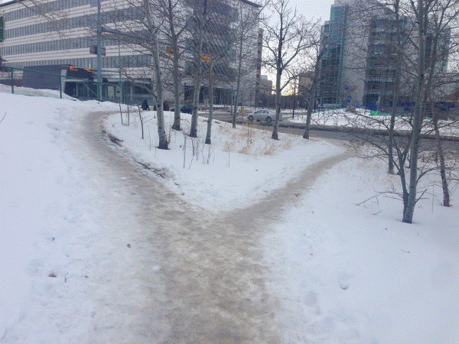
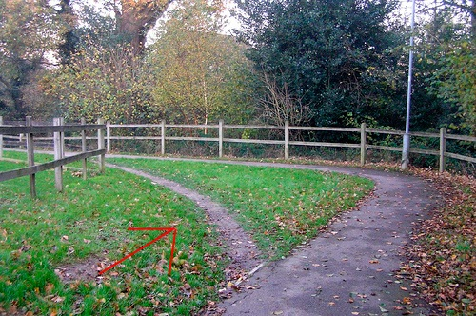
One of the more useful ways to create permanent paths is to average ones followed earlier. These naturally occurring paths are called “desire lines”.

Slide 131
The averaging process seems obvious, but it depends on metrics of distance
There are many!
Averaging points with the same station for different paths
Averaging the closest points from other paths to given points
Averaging points found by orthogonal projection from a path

Slide 132



Each of the averaging methods depends on how to define closeness of path points to each other
Use the same station. But they may be far apart?!
Average points close to each other. But they may be dispersed
Average points that are aligned orthogonally to some reference direction. But which direction?

Slide 133
This discrepancy in station distances is why lanes on track and field have staggered starts. The inside line would be shorter than the outside lane if everyone started at the same line.

Slide 134
Making sure paths are same lengths before averaging

Slide 136

Measuring nearness of a point to a path: three methods

Slide 137
Generating average trajectories by averaging trajectories at the same station

Slide 138
The “same station” method is just to average paths by station. This is done easily by just interpolation of all paths to same stations, then averaging.
It fails, however, when paths have different path lengths. As well, it tends to average points further and further apart from each other when moving along the path.
% script_test_fcn_Path_findAverageTraversalViaStationAlignment
% tests the function: fcn_Path_findAverageTraversalViaStationAlignment

Slide 139
Generating average trajectories by averaging points in proximity

Slide 140
The “closest point” method finds the closest point on a nearby path to the central path. It then finds the associated line segment on the nearby path, and then projects FROM the line segment back to the central path.
Note: the figures in this section can be produced by running: script_test_fcn_Path_findClosestPointsToTraversal.m

Slide 141
A function exists to find the closest points to a traversal from other traversals

Slide 142
The function, fcn_Path_findClosestPointsToTraversal implements the method described in the following slides to find the closest points on a traversal to a traversal
See: script_test_fcn_Path_findClosestPointsToTraversal
for examples

Slide 143
This method has the advantage of generating expected results even when the queries “graze” nearby paths

Slide 144
But this method gives unexpected results when the segment’s closest location is not actually on the segment.

Slide 145
Generally, the “closest point” method gives expected results when applied to adjacent paths

Slide 146
Using the closest traversal points, one can generate average trajectories by averaging points in proximity

Slide 147
The function, fcn_Path_findAverageTraversalViaClosestPoint implements closest-point averaging
See: script_test_fcn_Path_findAverageTraversalViaClosestPoint
for examples

Slide 148
The problem with closest point averaging is that the directions of the contributions can be unclear, e.g. the nearby path may be ahead or behind the station points on the central path.

Slide 149
Generating average trajectories by averaging orthogonal projections

Slide 150
Orthogonal projection takes a “central” trajectory, and then projects orthogonally from that trajectory at given stations to find where it hits nearby trajectories.
%% BASIC example 1 - parallel lines, query is in middle area
stations = 1; % Define the station
% Create a dummy central path and convert it to a traversal
central_path = [0 0; 2 0];
central_traversal = fcn_Path_convertXYtoTraversalStructure(central_path(:,1),central_path(:,2));
% Define a "nearby" path and convert it to a traversal
nearby_path = [0 4; 2 4];
nearby_traversal = fcn_Path_convertXYtoTraversalStructure(nearby_path(:,1),nearby_path(:,2));
% Calculate the closest point and distance on the nearby path
[closest_path_point,distances] = ...
fcn_Path_FindOrthogonalHitFromPathToPath(stations,central_traversal,nearby_traversal);
print_results(stations,closest_path_point,distances);

Slide 151
The approach gives the intersection point for arbitrary segments nearby the central trajectory
%% BASIC example 2 - angled line segment adjacent to endpoint query
stations = 1;
central_path = [0 0; 2 0];
central_traversal = fcn_Path_convertXYtoTraversalStructure(central_path(:,1),central_path(:,2));
nearby_path = [0 4; 2 7];
nearby_traversal = fcn_Path_convertXYtoTraversalStructure(nearby_path(:,1),nearby_path(:,2));
[closest_path_point,distances] = ...
fcn_Path_FindOrthogonalHitFromPathToPath(stations,central_traversal,nearby_traversal);
print_results(stations,closest_path_point,distances);

Slide 152
We define a “miss” to even include “grazing” from one trajectory to another
%% BASIC example 3 - angled line segment adjacent to endpoint query but near-miss
stations = 10;
central_path = [0 0; 10 0];
central_traversal = ...
fcn_Path_convertXYtoTraversalStructure(central_path(:,1),central_path(:,2));
nearby_path = [0 4; 10 7];
nearby_traversal = ...
fcn_Path_convertXYtoTraversalStructure(nearby_path(:,1),nearby_path(:,2));
[closest_path_point,distances] = ...
fcn_Path_FindOrthogonalHitFromPathToPath(stations,central_traversal,nearby_traversal);

Slide 153
A challenge with query stations is that the orthogonal projection is unclear. At the start and end, we use the segment ahead and behind these points.
NOTE: the code for the images here and in the next few slides can be found in: script_test_fcn_Path_FindOrthogonalHitFromPathToPath.m

Slide 154
As noted before in the orthogonal projection, the normal vectors are unclear at vertex points, and the path intersections can change depending on which type of averaging is used.

Slide 155
The same challenge arises for queries to the involuted area

Slide 156
One result of this process is that some areas of a nearby path may receive very poor sampling. Generally, portions of nearby paths that are parallel are sampled well, but perpendicular segments are not sampled at all.

Slide 157
For orthogonal projection, the option of averaging at the vertex appears to give the best results (e.g. flags 3 and 4 in orthogonal projections)

Slide 158
Of the three methods, the orthogonal one is most robust and clear. It is demonstrated next.

Slide 159
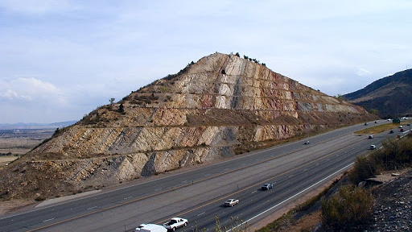
Using cross-cutting for path averaging

Slide 160
The particular advantage of the orthogonal projection is that every query “cuts” adjacent paths as one would expect.

Slide 161
There are several sub-functions required for orthogonal averaging

Slide 162
The function, fcn_Path_findOrthoScatterFromTraversalToTraversals implements this cutting process at given stations
See: script_test_fcn_Path_findOrthoScatterFromTraversalToTraversals
for examples

Slide 163
This allows one to average adjacent paths along each cut to produce an average path.
This is implemented in fcn_Path_findAverageTraversalViaOrthoProjection.m

Slide 164
The process of averaging has to avoid averaging paths that are nearby but not adjacent in the s-coordinate. Otherwise, the average may bias toward the alternate paths and may even “wander” at the intersections.
script_test_fcn_Path_findAveragePath.m

Slide 165
To force a query to include only a short part of a path, one can use: fcn_Path_findPathSXYSegment.m as mentioned earlier.
See script_test_fcn_Path_findPathSXYSegment for this demo

Slide 166
A comparison of the averaging methods shown here reveals that orthogonal projection cross-sections appear to work the best
See: script_test_fcn_Path_findAveragePath.m

Slide 167
Note that the orthogonal averaging function has the additional outputs of distance and XY hit points of the nearby paths, which allow statistics, detailed point analysis, and advanced plotting.
See: script_test_fcn_Path_findAveragePath

Slide 168
When doing the average, the starting traversal for the average is important as this “seeds” the search. The user can specify this reference_traversal as an input. If nothing is specified, the longest input traversal is used.
Reference = 1
Reference = 2
Reference = 3
Reference = (dumb)

Slide 169
Because orthogonal averaging uses iterations, the function allows the user to specify the number of iterations to try (default is 40, which is usually too much)
N = 1
N = 3
N = 10
N = 40

Slide 170
By turning on the debug flag within the function, one can see the iteration results (shown here for N=40)

Slide 171
Finally, the averaging process allows weighted smoothing to be used between iterations. A higher weight (from 0 to 1) means less of the new value is used. This prevents numerical oscillation (default is 0.8)

Slide 172
Finding the longest traversal within a traversals structure

Slide 173
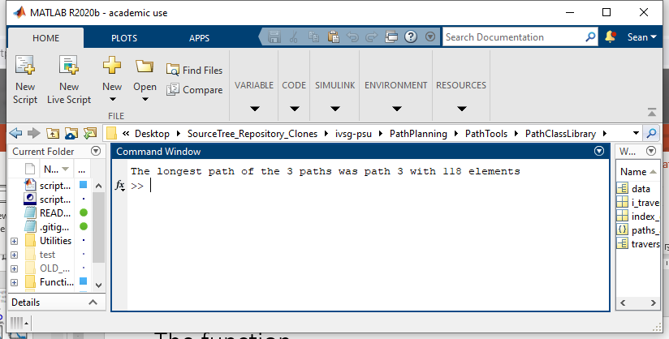
The function, fcn_Path_findTraversalWithMostData finds the traversal with the most data (e.g. most elements within an array)
This functionality is used to define the “default” reference traversal when doing orthogonal projection averaging.`
%% Finding the traversal with the most data, fcn_Path_findTraversalWithMostData
% finds the traversal index with the most amount of data (determined as the
% most elements in the X array)
% Fill in some dummy data
paths_array = fcn_Path_fillSamplePaths;
% Convert paths into traversals
for i_traveral = 1:length(paths_array)
traversal = fcn_Path_convertPathToTraversalStructure(paths_array{i_traveral});
data.traversal{i_traveral} = traversal;
end
index_of_longest = fcn_Path_findTraversalWithMostData(data);
fprintf(1,'The longest path of the %.0d paths was path %.0d with %.0d elements\n',...
length(data.traversal),...
index_of_longest,...
length(data.traversal{index_of_longest}.X));

Slide 174
Generating new trajectories by resampling trajectories at specific stations

Slide 175
The function, fcn_Path_newTraversalByStationResampling implements a station resampling process
See: script_test_fcn_Path_newTraversalByStationResampling
for examples
%% Finding the traversal with the most data, fcn_Path_findTraversalWithMostData
% finds the traversal index with the most amount of data (determined as the
% most elements in the X array)
% Fill in some dummy data
paths_array = fcn_Path_fillSamplePaths;
% Convert paths into traversals
for i_traveral = 1:length(paths_array)
traversal = fcn_Path_convertPathToTraversalStructure(paths_array{i_traveral});
data.traversal{i_traveral} = traversal;
end
index_of_longest = fcn_Path_findTraversalWithMostData(data);
fprintf(1,'The longest path of the %.0d paths was path %.0d with %.0d elements\n',...
length(data.traversal),...
index_of_longest,...
length(data.traversal{index_of_longest}.X));

Slide 176
Generating new trajectories by resampling trajectories at specific stations

Slide 177
The function, fcn_Path_cleanPathFromForwardBackwardJogs removes forward/backward oscillations caused by averaging data spatially
The main approach therein is to examine the change in relative yaw angle between segments, removing those that are too large.
%% Example 1: Basic call
fig_num = 1;
path_with_jogs = [0 0; 1 1; 2 2.2; 3.3 3; 2.5 2.7; 3.5 3.6; 5 5];
clean_path = fcn_Path_cleanPathFromForwardBackwardJogs...
(path_with_jogs,fig_num);
plot(path_with_jogs(:,1), path_with_jogs(:,2),'.-','Linewidth',2,'Markersize',25);
plot(clean_path(:,1), clean_path(:,2),'.-','Linewidth',2,'Markersize',25);
title('Original path with jogs and cleaned path')
xlabel('X [m]')
ylabel('Y [m]')

Slide 179

Elevated paths

Slide 180
Elevated path operations include
(fill this in)
These basic functions are described below.

Slide 181
What is an elevated path?
An elevated path is a set of [X Y Z] points as a N x 3 vector or array. These X Y Z rows denote the locations we are trying to follow, in 3D, which defines the elevated path. For example:
An elevated path type must have at least 2 rows so that at least one “path segment” can be defined.
paths{1} = [
8.1797 8.6006 0.1
8.4101 15.8892 0.2
10.0230 25.5102 -0.1
10.4839 39.7959 0.3];

Slide 182
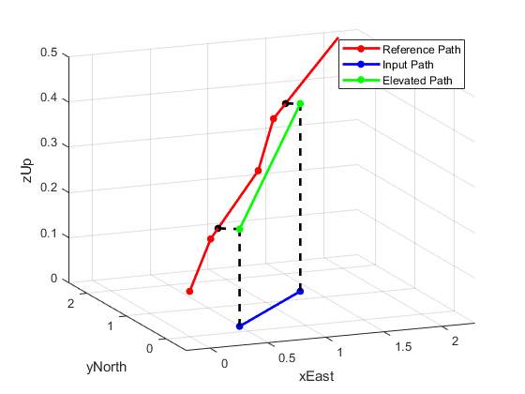
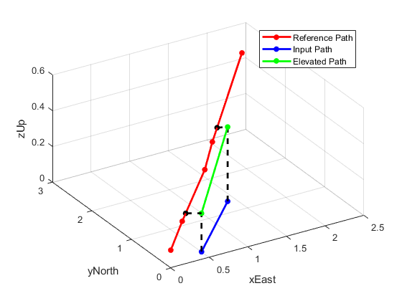
fcn_Path_addElevationToPath adds elevation to a `path’ by finding two nearest neighbors in an `elevated path’ and interpolating their elevations
%% BASIC example 1.3 - works
point = [0.5 0.2; 1.4 1.3]; % Define the query point as an XY
reference_elevated_path = [0 0 0.1; 0.25 0.2 0.2; 0.9 0.9 0.3; 1.1 1.1 0.4; 2.3 2.7 0.5]; % Define an XYZ path
fignum = 113; % Define the figure number
% Snap the point onto the path
elevated_path = fcn_Path_addElevationToPath(point, reference_elevated_path, fignum);

